Slide 1
RTコンポーネント作成入門
宮本 信彦
国立研究開発法人産業技術総合研究所
インダストリアルCPS研究センター
ソフトウェアプラットフォーム研究チーム

Slide 2
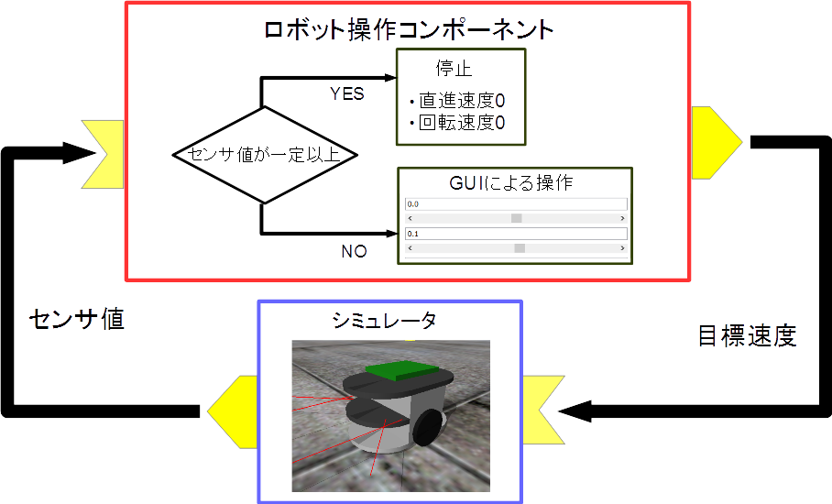
実習内容
シミュレータ上の車輪型移動ロボット(Raspberry Piマウス)の操作を行うコンポーネントの作成
GUIにより目標速度入力
センサ値が一定以上の場合に停止
2
Notes:
2

Slide 3
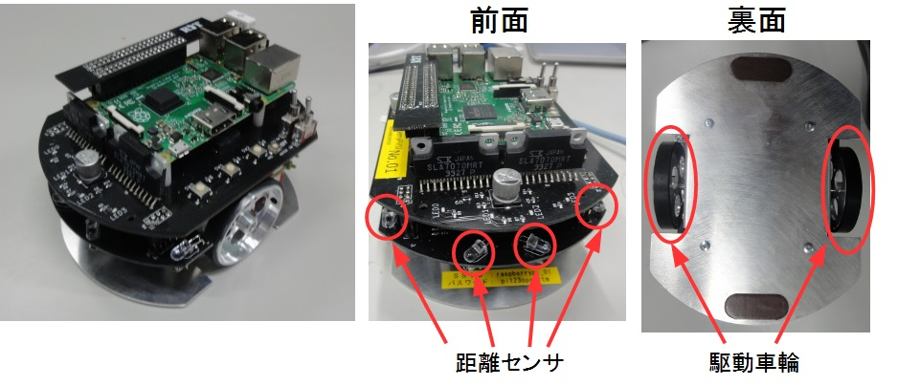
Raspberry Piマウス概要
Raspberry Piマウスはアールティが販売している独立二輪駆動型の移動ロボット
3
Notes:
3

Slide 4
全体の手順
RTC Builderによるソースコード等のひな型の作成
ソースコードの編集、ビルド
ビルドに必要な各種ファイルを生成
CMakeにより各種ファイル生成
ソースコードの編集
RobotController.h、 RobotController.cppの編集
ビルド
Visual Studio、Code::Blocks
RTシステムエディタによるRTシステム作成、動作確認
RTシステム作成
データポート接続、コンフィギュレーションパラメータ設定
4
Notes:
4
At first, I’d like to mention about RT.
What is RT?
RT means Robot Technology.
This is not only standalone robots like this, but also robotic elements, sensors, actuators and so on.
We have studied on RT-Middleware.
RT-Middleware is software platform to integrate these RT-elements.

Slide 5
コンポーネント開発ツール
RTC Builderについて

Slide 6

RTC Builder
コンポーネントのプロファイル情報を入力し，ソースコード等のひな型を生成するツール
C++、Python、Java、Luaのソースコードを出力
6
Notes:
6
At first, I’d like to mention about RT.
What is RT?
RT means Robot Technology.
This is not only standalone robots like this, but also robotic elements, sensors, actuators and so on.
We have studied on RT-Middleware.
RT-Middleware is software platform to integrate these RT-elements.

Slide 7

RTC Builderの起動
起動する手順
Windows(OpenRTM-aist 1.2)
デスクトップのショートカットをダブルクリック
デスクトップのショートカットがない場合
Windows 7
「スタート」→「すべてのプログラム」→「OpenRTM-aist 1.2.0」→「Tools」→「OpenRTP」
Windows 8.1
「スタート」→「アプリビュー(右下矢印)」→「OpenRTM-aist 1.2.0」→「OpenRTP」
※同じフォルダに「RTSystemEditorRCP」がありますが、これはRTC Builderが使えないので今回は「OpenRTP」を起動してください。
Windows 10
左下の「ここに入力して検索」にOpenRTPと入力して、表示されたOpenRTPを起動
Ubuntu
以下のコマンドを入力
$ openrtp
7
Notes:
7
At first, I’d like to mention about RT.
What is RT?
RT means Robot Technology.
This is not only standalone robots like this, but also robotic elements, sensors, actuators and so on.
We have studied on RT-Middleware.
RT-Middleware is software platform to integrate these RT-elements.

Slide 8
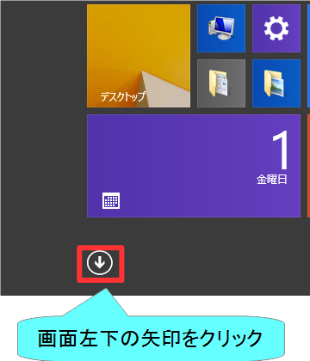
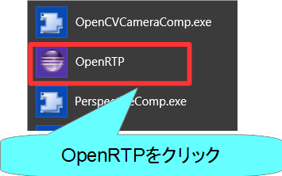
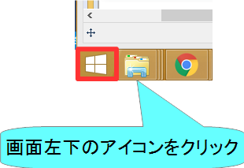
RTC Builderの起動
Windows 8.1
デスクトップ
スタート画面
アプリビュー
8
Notes:
8
At first, I’d like to mention about RT.
What is RT?
RT means Robot Technology.
This is not only standalone robots like this, but also robotic elements, sensors, actuators and so on.
We have studied on RT-Middleware.
RT-Middleware is software platform to integrate these RT-elements.

Slide 9
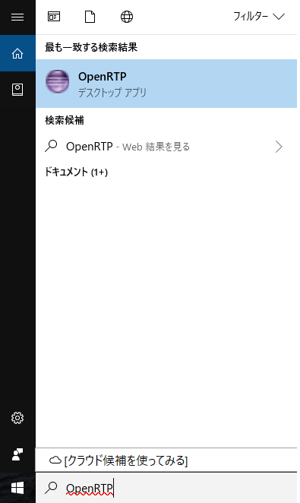
RTC Builderの起動
Windows 10
左下の「ここに入力して検索」に「OpenRTP」と入力
9
Notes:
9
At first, I’d like to mention about RT.
What is RT?
RT means Robot Technology.
This is not only standalone robots like this, but also robotic elements, sensors, actuators and so on.
We have studied on RT-Middleware.
RT-Middleware is software platform to integrate these RT-elements.

Slide 10
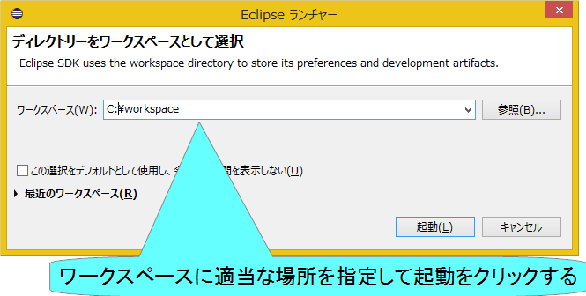
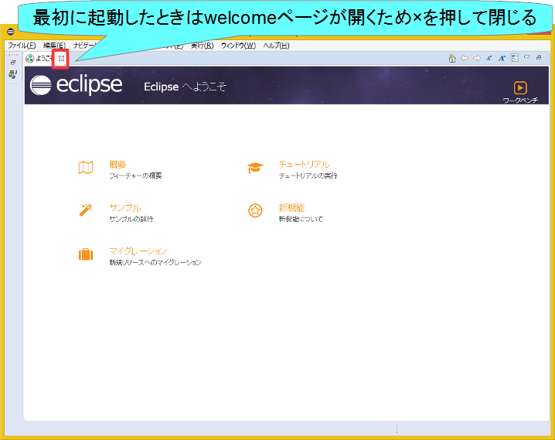
RTC Builderの起動
10
Notes:
10
At first, I’d like to mention about RT.
What is RT?
RT means Robot Technology.
This is not only standalone robots like this, but also robotic elements, sensors, actuators and so on.
We have studied on RT-Middleware.
RT-Middleware is software platform to integrate these RT-elements.

Slide 11
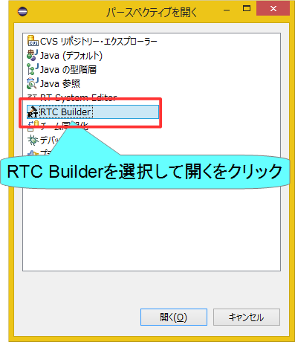

RTC Builderの起動
11
Notes:
11
At first, I’d like to mention about RT.
What is RT?
RT means Robot Technology.
This is not only standalone robots like this, but also robotic elements, sensors, actuators and so on.
We have studied on RT-Middleware.
RT-Middleware is software platform to integrate these RT-elements.

Slide 12
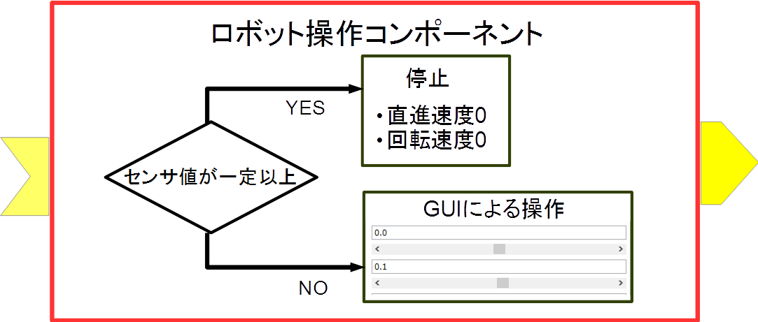
プロジェクト作成
RobotControllerコンポーネントのスケルトンコードを作成する。
車輪型移動ロボット操作コンポーネント
GUIでロボットを操作
センサ値が一定以上の場合に停止
12
Notes:
12
At first, I’d like to mention about RT.
What is RT?
RT means Robot Technology.
This is not only standalone robots like this, but also robotic elements, sensors, actuators and so on.
We have studied on RT-Middleware.
RT-Middleware is software platform to integrate these RT-elements.

Slide 13
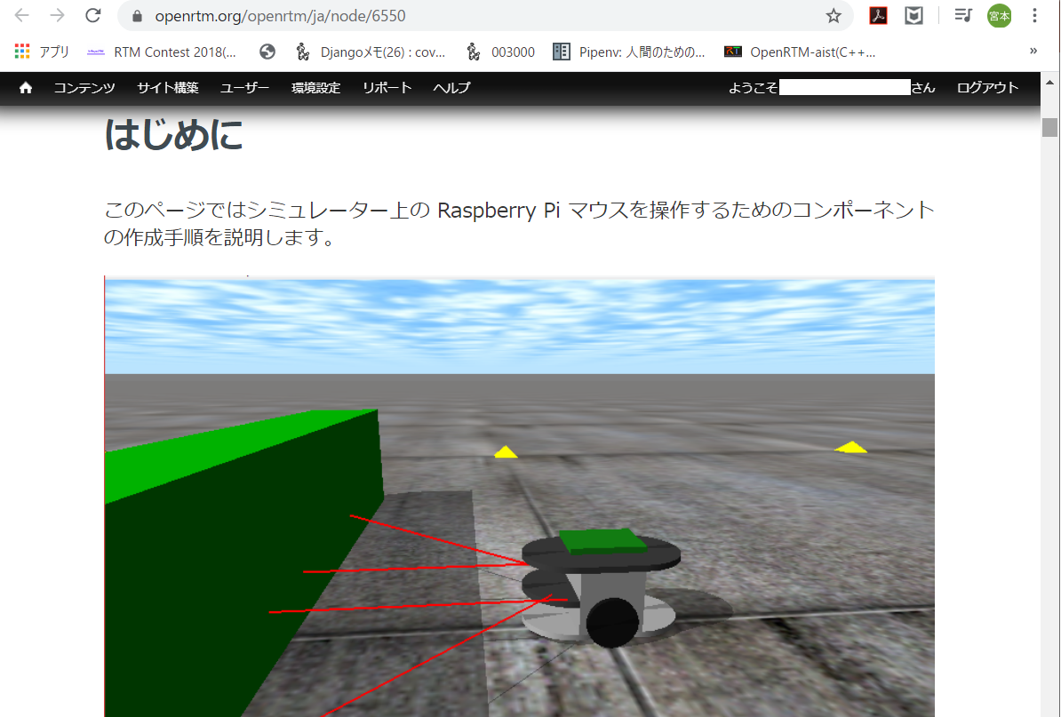
資料
Windowsの場合
配布資料の「WEBpage」フォルダ内の以下のHTMLファイル
チュートリアル(RTコンポーネントの作成入門、Raspberry Pi Mouse、Windows) _ OpenRTM-aist.html
または、https://openrtm.org/openrtm/ja/node/6550
Ubuntuの場合
配布資料の「WEBpage」フォルダ内の以下のHTMLファイル
チュートリアル(RTコンポーネントの作成入門、Raspberry Pi Mouse、Ubuntu) _ OpenRTM-aist.html
または、https://openrtm.org/openrtm/ja/node/6551
13
Notes:
13
At first, I’d like to mention about RT.
What is RT?
RT means Robot Technology.
This is not only standalone robots like this, but also robotic elements, sensors, actuators and so on.
We have studied on RT-Middleware.
RT-Middleware is software platform to integrate these RT-elements.

Slide 14
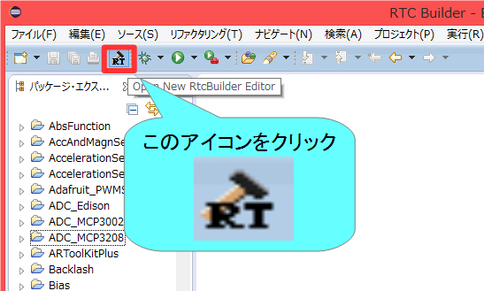
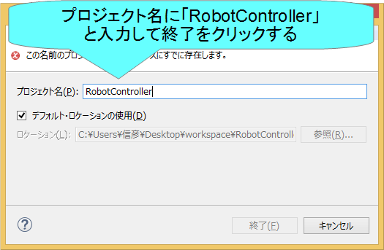
プロジェクト作成
Eclipse起動時にワークスペースに指定したディレクトリに「RobotController」というフォルダが作成される
この時点では「RTC.xml」と「.project」のみが生成されている
以下の項目が設定する
基本プロファイル
アクティビティ・プロファイル
データポート・プロファイル
サービスポート・プロファイル
コンフィギュレーション
ドキュメント
言語環境
RTC.xml
14
Notes:
14
At first, I’d like to mention about RT.
What is RT?
RT means Robot Technology.
This is not only standalone robots like this, but also robotic elements, sensors, actuators and so on.
We have studied on RT-Middleware.
RT-Middleware is software platform to integrate these RT-elements.

Slide 15
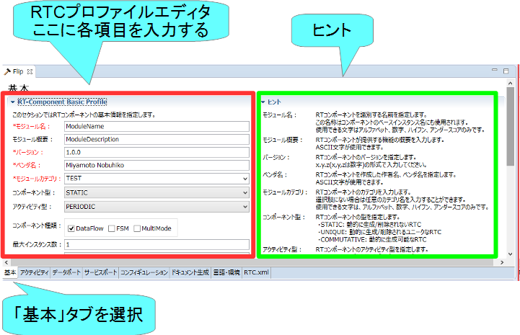
基本プロファイルの入力
RTコンポーネントのプロファイル情報など，コンポーネントの基本情報を設定．
コード生成，インポート/エクスポート，パッケージング処理を実行
15
Notes:
15
At first, I’d like to mention about RT.
What is RT?
RT means Robot Technology.
This is not only standalone robots like this, but also robotic elements, sensors, actuators and so on.
We have studied on RT-Middleware.
RT-Middleware is software platform to integrate these RT-elements.

Slide 16
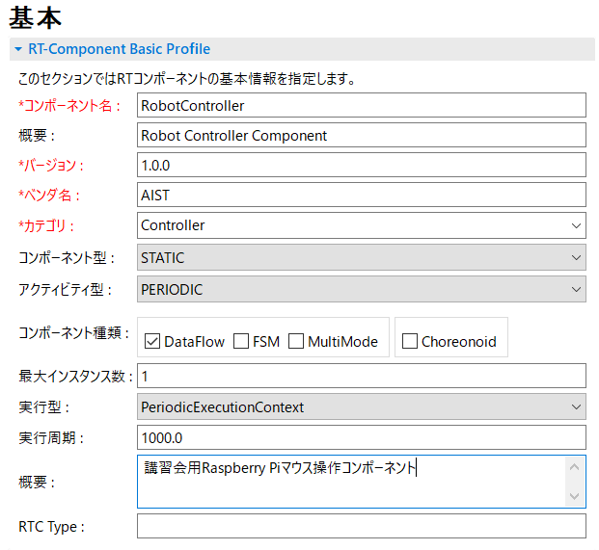
基本プロファイルの入力
コンポーネント名
RobotController
モジュール概要
任意(Robot Controller Component)
バージョン
任意(1.0.0)
ベンダ名
任意
モジュールカテゴリ
任意(Controller)
コンポーネント型
STATIC
アクティビティ型
PERIODIC
コンポーネントの種類
DataFlow
最大インスタンス数
1
実行型
PeriodicExecutionContext
実行周期
1000.0
概要
任意
16
Notes:
16
At first, I’d like to mention about RT.
What is RT?
RT means Robot Technology.
This is not only standalone robots like this, but also robotic elements, sensors, actuators and so on.
We have studied on RT-Middleware.
RT-Middleware is software platform to integrate these RT-elements.

Slide 17
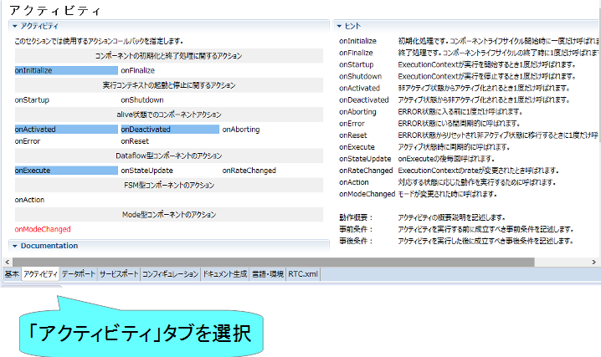
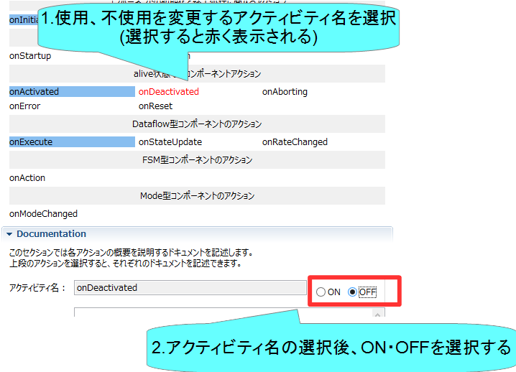
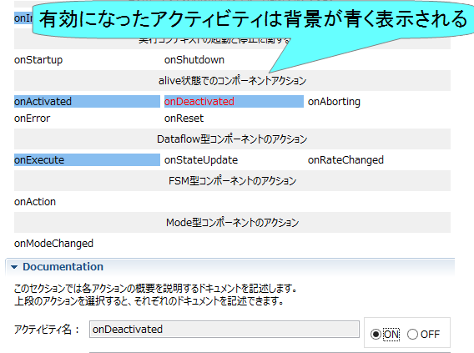
アクティビティの設定
使用するアクティビティを設定する
指定アクティビティを有効にする手順
Notes:
17
At first, I’d like to mention about RT.
What is RT?
RT means Robot Technology.
This is not only standalone robots like this, but also robotic elements, sensors, actuators and so on.
We have studied on RT-Middleware.
RT-Middleware is software platform to integrate these RT-elements.

Slide 18
アクティビティの設定
コールバック関数 | 処理
onInitialize | 初期化処理
onActivated | アクティブ化されるとき1度だけ呼ばれる
onExecute | アクティブ状態時に周期的に呼ばれる
onDeactivated | 非アクティブ化されるとき1度だけ呼ばれる
onAborting | ERROR状態に入る前に1度だけ呼ばれる
onReset | resetされる時に1度だけ呼ばれる
onError | ERROR状態のときに周期的に呼ばれる
onFinalize | 終了時に1度だけ呼ばれる
onStateUpdate | onExecuteの後毎回呼ばれる
onRateChanged | ExecutionContextのrateが変更されたとき1度だけ呼ばれる
onStartup | ExecutionContextが実行を開始するとき1度だけ呼ばれる
onShutdown | ExecutionContextが実行を停止するとき1度だけ呼ばれる
18
Notes:
18
At first, I’d like to mention about RT.
What is RT?
RT means Robot Technology.
This is not only standalone robots like this, but also robotic elements, sensors, actuators and so on.
We have studied on RT-Middleware.
RT-Middleware is software platform to integrate these RT-elements.

Slide 19

アクティビティの設定
以下のアクティビティを有効にする
onInitialize
onActivated
onDeactivated
onExecute
今回は練習のため、Documentationは空白でも大丈夫です
19
Notes:
19
At first, I’d like to mention about RT.
What is RT?
RT means Robot Technology.
This is not only standalone robots like this, but also robotic elements, sensors, actuators and so on.
We have studied on RT-Middleware.
RT-Middleware is software platform to integrate these RT-elements.

Slide 20
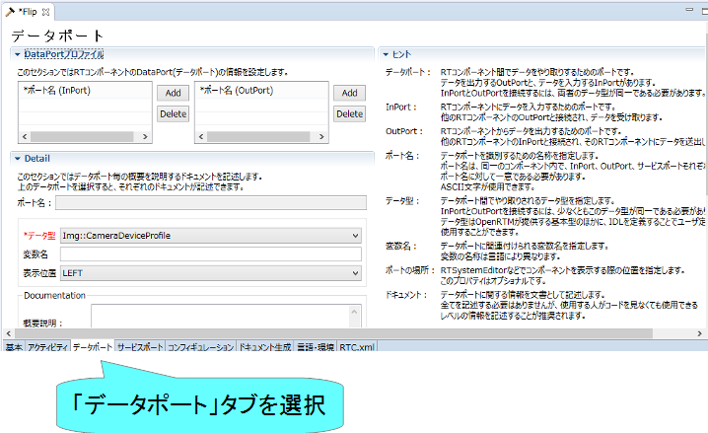
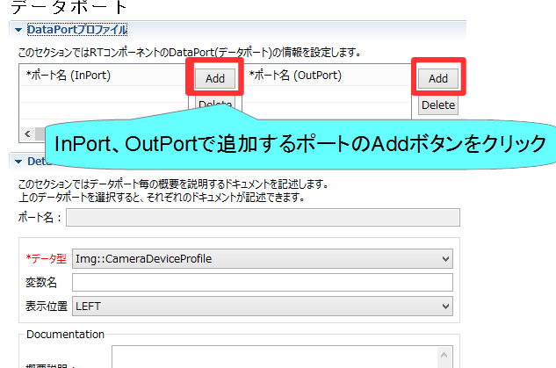
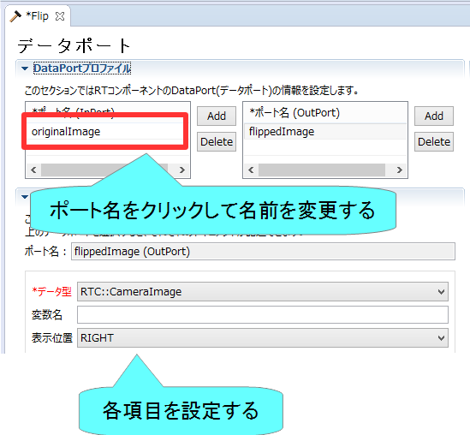
データポートの設定
InPort、OutPortの追加、設定を行う
データポートを追加する手順
Notes:
20
At first, I’d like to mention about RT.
What is RT?
RT means Robot Technology.
This is not only standalone robots like this, but also robotic elements, sensors, actuators and so on.
We have studied on RT-Middleware.
RT-Middleware is software platform to integrate these RT-elements.

Slide 21
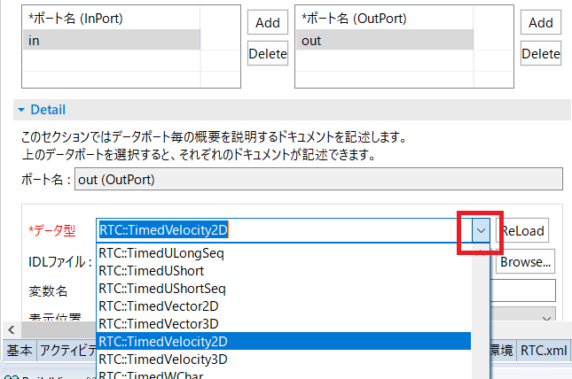
データポートの設定
以下のInPortを設定する
in
データ型： RTC::TimedShortSeq
他の項目は任意
※TimedShort型と間違えないようにしてください。
以下のOutPortを設定する
out
データ型： RTC::TimedVelocity2D
他の項目は任意
※TimedVelocity3D型、TimedVector2Dと間違えないようにしてください
データ型はドロップダウンリストから選択する
Notes:
21
At first, I’d like to mention about RT.
What is RT?
RT means Robot Technology.
This is not only standalone robots like this, but also robotic elements, sensors, actuators and so on.
We have studied on RT-Middleware.
RT-Middleware is software platform to integrate these RT-elements.

Slide 22


データポートについて
連続したデータを通信するためのポート
以下の例はデータフロー型がpush、サブスクリプション型がflush、インターフェース型がcorba_cdrの場合
Notes:
22
At first, I’d like to mention about RT.
What is RT?
RT means Robot Technology.
This is not only standalone robots like this, but also robotic elements, sensors, actuators and so on.
We have studied on RT-Middleware.
RT-Middleware is software platform to integrate these RT-elements.

Slide 23
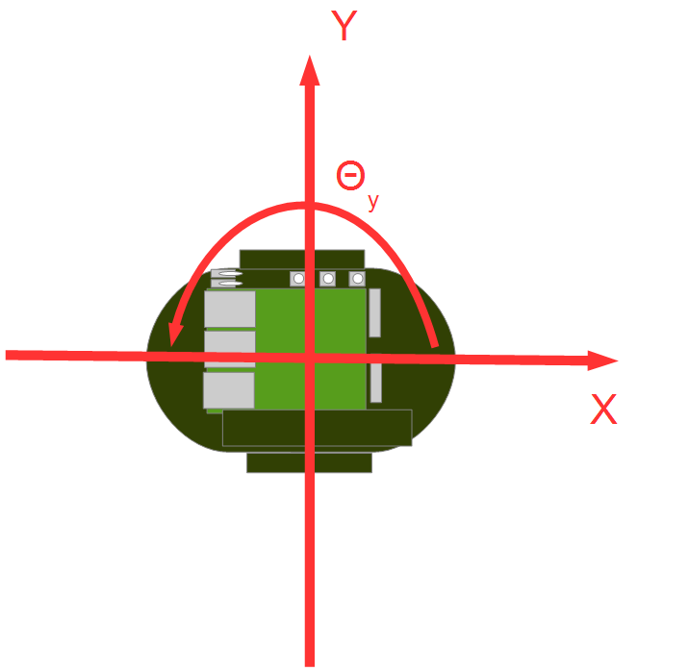

RTC::TimedVelocity2D型について
ExtendedDataTypes.idlで定義されている移動ロボットの速度を表現するためのデータ型
vx: X軸方向の速度
vy: Y軸方向の速度(車輪が横滑りしないと仮定すると0)
va: Z軸周りの角速度
vxで直進速度、vaで回転速度を設定
Notes:
23
At first, I’d like to mention about RT.
What is RT?
RT means Robot Technology.
This is not only standalone robots like this, but also robotic elements, sensors, actuators and so on.
We have studied on RT-Middleware.
RT-Middleware is software platform to integrate these RT-elements.

Slide 24
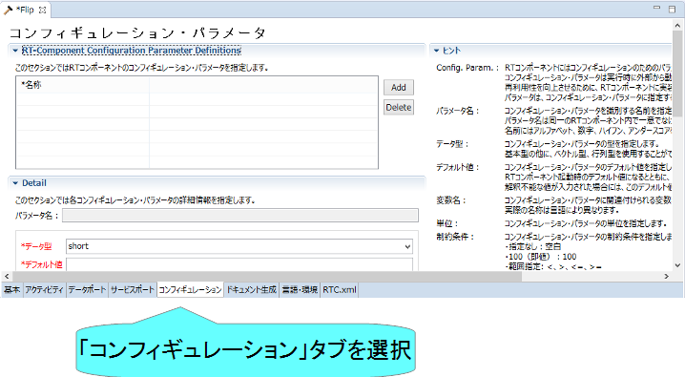
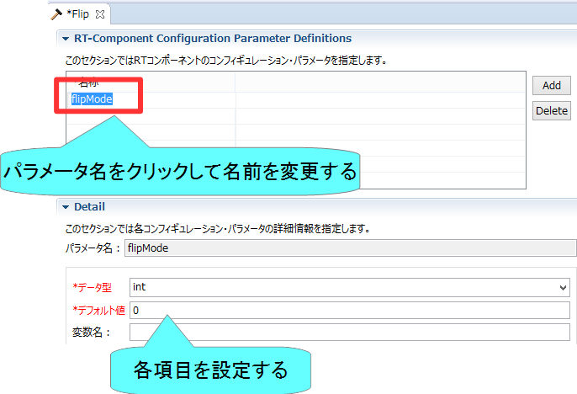
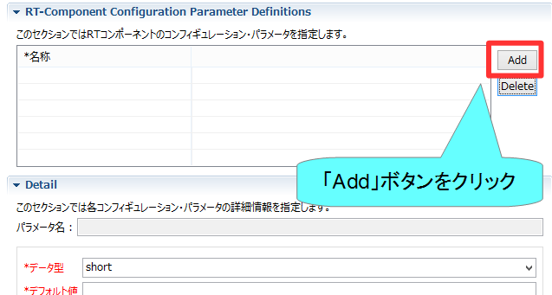
コンフィギュレーションの設定
コンフィギュレーションパラメータの追加、設定を行う
コンフィギュレーションパラメータを追加する手順
Notes:
24
At first, I’d like to mention about RT.
What is RT?
RT means Robot Technology.
This is not only standalone robots like this, but also robotic elements, sensors, actuators and so on.
We have studied on RT-Middleware.
RT-Middleware is software platform to integrate these RT-elements.

Slide 25
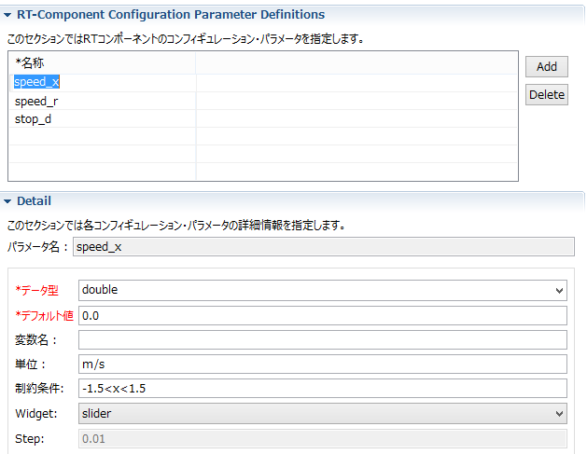

コンフィギュレーションの設定
以下のコンフィギュレーションパラメータを設定する
speed_x
データ型：double
デフォルト値： 0.0
制約条件：-1.5<x<1.5
Widget：slider
Step: 0.01
他の項目は任意
speed_r
データ型：double
デフォルト値： 0.0
制約条件：-2.0<x<2.0
Widget：slider
Step: 0.01
他の項目は任意
GUI(スライダー)による移動ロボットの操作ができるようにする
Notes:
25
At first, I’d like to mention about RT.
What is RT?
RT means Robot Technology.
This is not only standalone robots like this, but also robotic elements, sensors, actuators and so on.
We have studied on RT-Middleware.
RT-Middleware is software platform to integrate these RT-elements.

Slide 26

コンフィギュレーションパラメータの制約、Widgetの設定
RT System Editorでコンフィギュレーションパラメータを編集する際にGUIを表示する
Widget：text
制約条件：0<=x<=100
Widget：spin
Step：10
制約条件：0<=x<=100
Widget：slider
Step：10
Notes:
26
At first, I’d like to mention about RT.
What is RT?
RT means Robot Technology.
This is not only standalone robots like this, but also robotic elements, sensors, actuators and so on.
We have studied on RT-Middleware.
RT-Middleware is software platform to integrate these RT-elements.

Slide 27



コンフィギュレーションパラメータの制約、Widgetの設定
制約条件：(0,1,2,3)
Widget：radio
制約条件：(0,1,2,3)
Widget：checkbox
制約条件：(0,1,2,3)
Widget：ordered_list
Notes:
27
At first, I’d like to mention about RT.
What is RT?
RT means Robot Technology.
This is not only standalone robots like this, but also robotic elements, sensors, actuators and so on.
We have studied on RT-Middleware.
RT-Middleware is software platform to integrate these RT-elements.

Slide 28
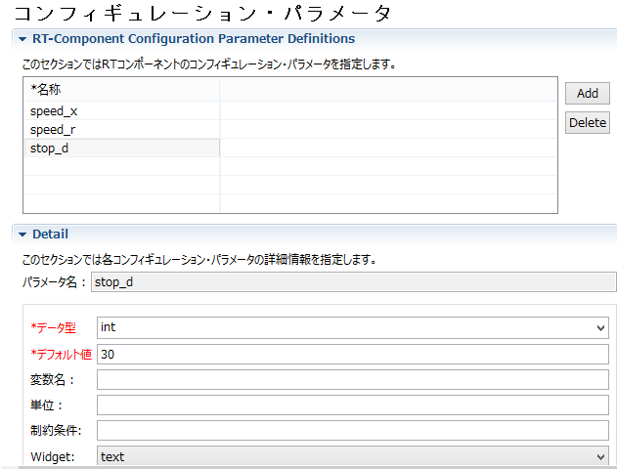
コンフィギュレーションの設定
以下のコンフィギュレーションパラメータを追加
stop_d
データ型：int
デフォルト値： 30
他の項目は任意
センサ値がこの値以上の場合に停止
Notes:
28
At first, I’d like to mention about RT.
What is RT?
RT means Robot Technology.
This is not only standalone robots like this, but also robotic elements, sensors, actuators and so on.
We have studied on RT-Middleware.
RT-Middleware is software platform to integrate these RT-elements.

Slide 29
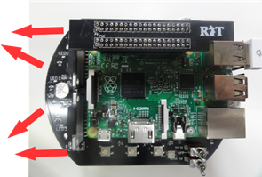
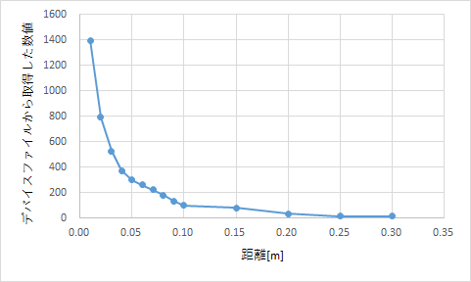
Raspberry Piマウスの距離センサ
Raspberry Piマウス実機には距離センサが搭載されている
計測した値は物体までの距離が近いほど大きな値となる
シミュレータでもこのデータに近い値を計算して出力している
Notes:
29
At first, I’d like to mention about RT.
What is RT?
RT means Robot Technology.
This is not only standalone robots like this, but also robotic elements, sensors, actuators and so on.
We have studied on RT-Middleware.
RT-Middleware is software platform to integrate these RT-elements.

Slide 30
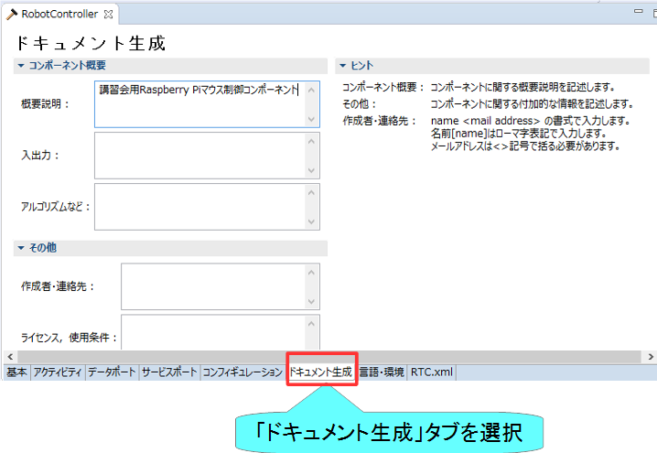
ドキュメントの設定
各種ドキュメント情報を設定
今回は適当に設定しておいてください。
空白でも大丈夫です
Notes:
30
At first, I’d like to mention about RT.
What is RT?
RT means Robot Technology.
This is not only standalone robots like this, but also robotic elements, sensors, actuators and so on.
We have studied on RT-Middleware.
RT-Middleware is software platform to integrate these RT-elements.

Slide 31
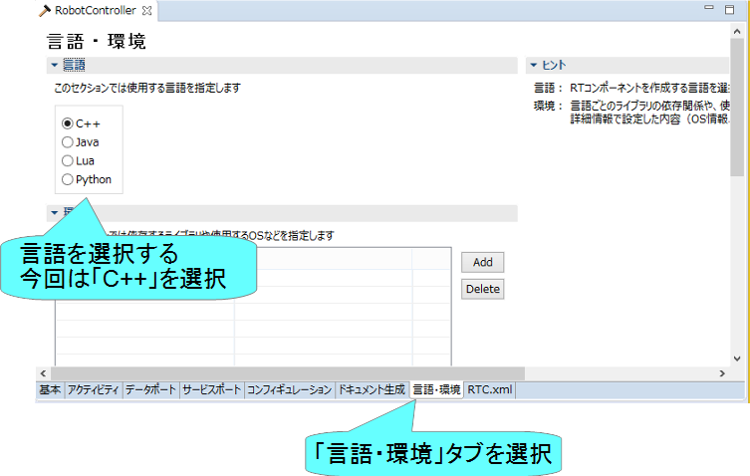
言語の設定
実装する言語，動作環境に関する情報を設定
Notes:
31
At first, I’d like to mention about RT.
What is RT?
RT means Robot Technology.
This is not only standalone robots like this, but also robotic elements, sensors, actuators and so on.
We have studied on RT-Middleware.
RT-Middleware is software platform to integrate these RT-elements.

Slide 32
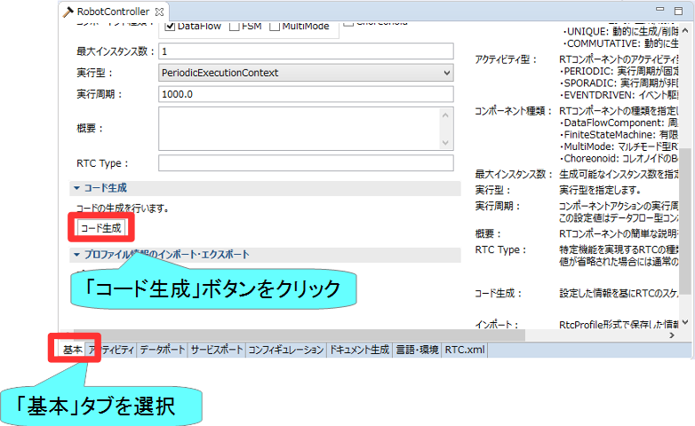
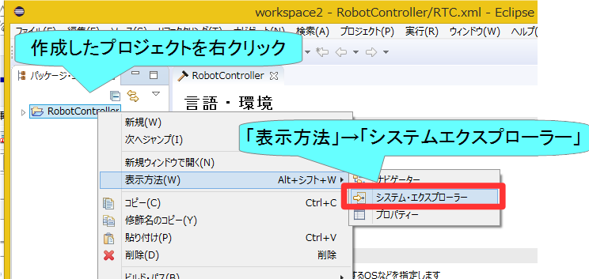
スケルトンコードの生成
基本タブからコード生成ボタンを押すことでスケルトンコードが生成される
Workspace\RobotController以下に生成
ソースコード
C++ソースファイル(.cpp)
ヘッダーファイル(.h)
このソースコードにロボットを操作する処理を記述する
CMakeの設定ファイル(CMakeLists.txt)
rtc.conf、RobotController.conf
以下略
生成したファイルの確認
作成したプロジェクトを右クリックして、「表示方法」→「システムエクスプローラー」を選択する
エクスプローラーでワークスペースのフォルダが開くため、上記のファイルが存在するかを確認する
Notes:
32
At first, I’d like to mention about RT.
What is RT?
RT means Robot Technology.
This is not only standalone robots like this, but also robotic elements, sensors, actuators and so on.
We have studied on RT-Middleware.
RT-Middleware is software platform to integrate these RT-elements.

Slide 33
手順
ビルドに必要な各種ファイルを生成
CMakeにより各種ファイル生成
ソースコードの編集
RobotController.hの編集
RobotController.cppの編集
ビルド
Windows： Visual Studio
Ubuntu： Code::Blocks
33
Notes:
33
At first, I’d like to mention about RT.
What is RT?
RT means Robot Technology.
This is not only standalone robots like this, but also robotic elements, sensors, actuators and so on.
We have studied on RT-Middleware.
RT-Middleware is software platform to integrate these RT-elements.

Slide 34
ソースコードの編集、RTCのビルド

Slide 35
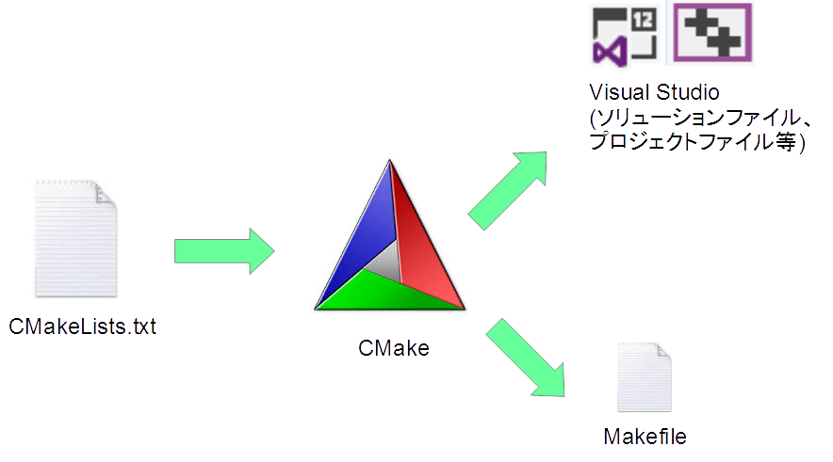
CMake
ビルドに必要な各種ファイルを生成
CMakeLists.txtに設定を記述
RTC Builderでスケルトンコードを作成した時にCMakeLists.txtも生成されている
35
Notes:
35
At first, I’d like to mention about RT.
What is RT?
RT means Robot Technology.
This is not only standalone robots like this, but also robotic elements, sensors, actuators and so on.
We have studied on RT-Middleware.
RT-Middleware is software platform to integrate these RT-elements.

Slide 36
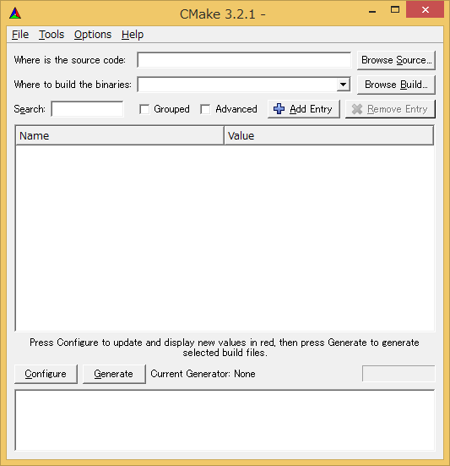
ビルドに必要なファイルの生成
CMakeを使用する
Windows 7
「スタート」→「すべてのプログラム」→「CMake」→「CMake (cmake-gui)」
Windows 8.1
「スタート」→「アプリビュー(右下矢印)」→「CMake」→「CMake (cmake-gui)」
Windows 10
左下の「ここに入力して検索」にCMakeと入力して表示されたCMake(cmake-gui)を起動
Ubuntu
コマンドで「cmake-gui」を入力
36
Notes:
36
At first, I’d like to mention about RT.
What is RT?
RT means Robot Technology.
This is not only standalone robots like this, but also robotic elements, sensors, actuators and so on.
We have studied on RT-Middleware.
RT-Middleware is software platform to integrate these RT-elements.

Slide 37
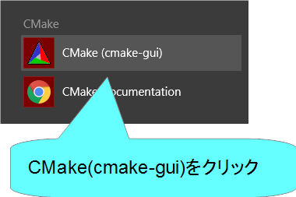
cmake-guiの起動
Windows 8.1
デスクトップ
スタート画面
アプリビュー
37
Notes:
37
At first, I’d like to mention about RT.
What is RT?
RT means Robot Technology.
This is not only standalone robots like this, but also robotic elements, sensors, actuators and so on.
We have studied on RT-Middleware.
RT-Middleware is software platform to integrate these RT-elements.

Slide 38
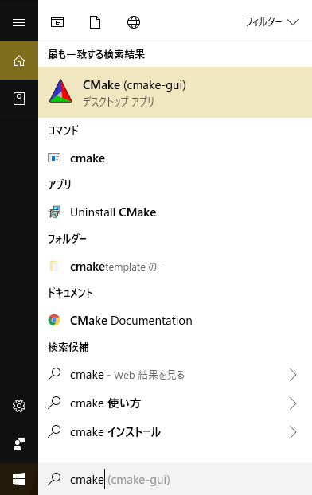
cmake-guiの起動
Windows 10
左下の「ここに入力して検索」に「cmake」と入力
38
Notes:
38
At first, I’d like to mention about RT.
What is RT?
RT means Robot Technology.
This is not only standalone robots like this, but also robotic elements, sensors, actuators and so on.
We have studied on RT-Middleware.
RT-Middleware is software platform to integrate these RT-elements.

Slide 39
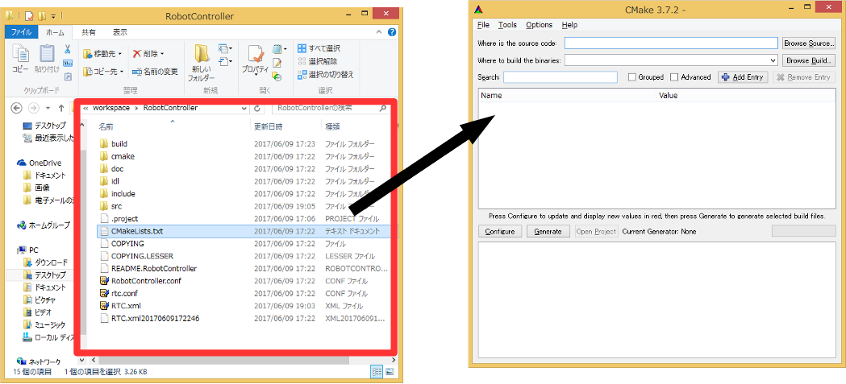
ビルドに必要なファイルの生成
CMakeLists.txtをcmake-guiにドラックアンドドロップ
CMakeLists.txtはRTC Builderで生成したプロジェクトのフォルダ
(例： C:\workspace\RobotController)
39
Notes:
39
At first, I’d like to mention about RT.
What is RT?
RT means Robot Technology.
This is not only standalone robots like this, but also robotic elements, sensors, actuators and so on.
We have studied on RT-Middleware.
RT-Middleware is software platform to integrate these RT-elements.

Slide 40
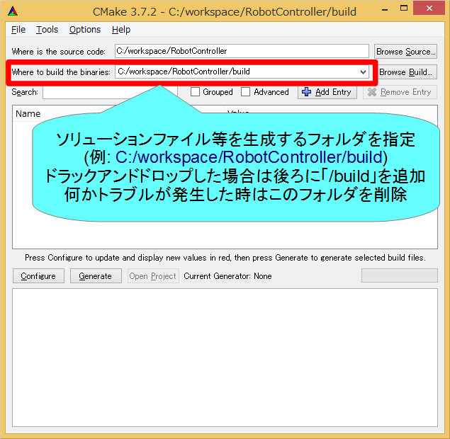
ビルドに必要なファイルの生成
40
Notes:
40
At first, I’d like to mention about RT.
What is RT?
RT means Robot Technology.
This is not only standalone robots like this, but also robotic elements, sensors, actuators and so on.
We have studied on RT-Middleware.
RT-Middleware is software platform to integrate these RT-elements.

Slide 41
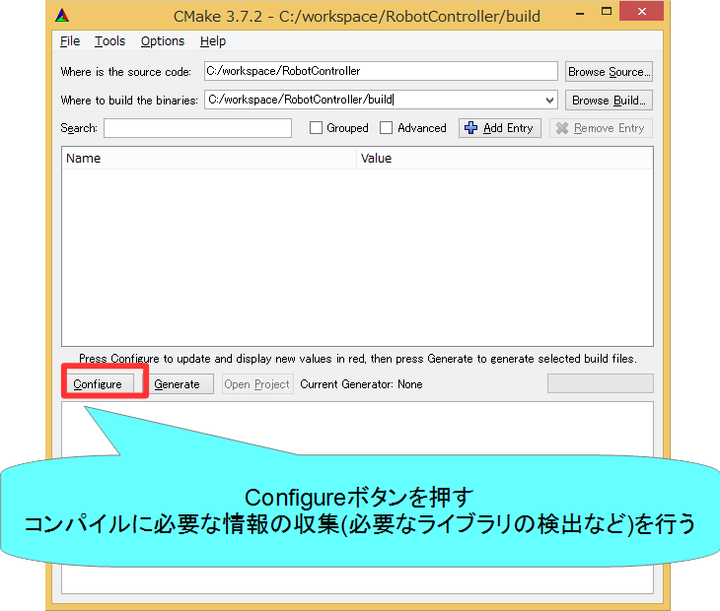
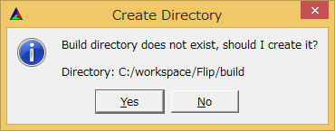
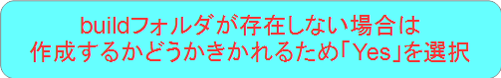
ビルドに必要なファイルの生成
41
Notes:
41
At first, I’d like to mention about RT.
What is RT?
RT means Robot Technology.
This is not only standalone robots like this, but also robotic elements, sensors, actuators and so on.
We have studied on RT-Middleware.
RT-Middleware is software platform to integrate these RT-elements.

Slide 42
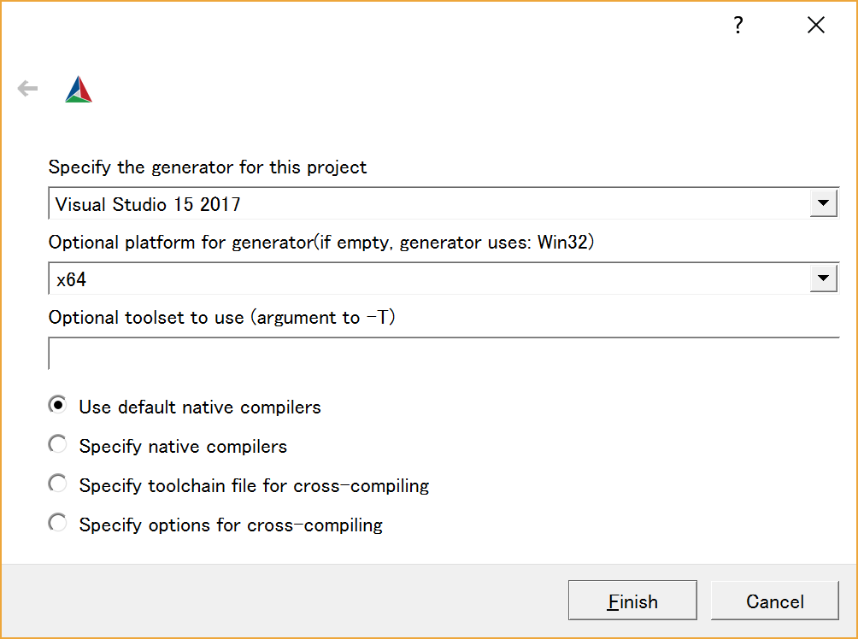
CMake 3.14以降の場合
ビルド環境の設定
Visual Studio 2017 → Visual Studio 15 2017
Visual Studio 2013 → Visual Studio 12 2013
※貸し出したPCでは「Visual Studio 14 2015」を指定
X64を選択する。
設定後、Finishボタンを押す
42
Notes:
42
At first, I’d like to mention about RT.
What is RT?
RT means Robot Technology.
This is not only standalone robots like this, but also robotic elements, sensors, actuators and so on.
We have studied on RT-Middleware.
RT-Middleware is software platform to integrate these RT-elements.

Slide 43
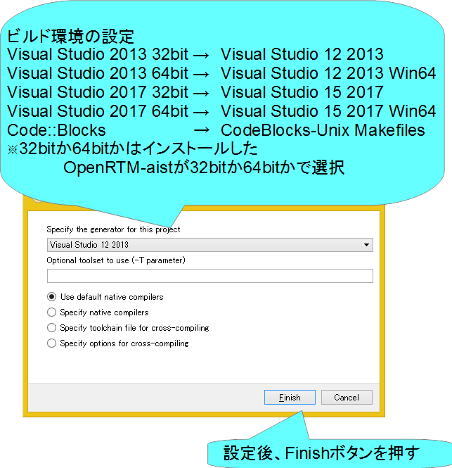
CMake 3.13以前の場合
43
Notes:
43
At first, I’d like to mention about RT.
What is RT?
RT means Robot Technology.
This is not only standalone robots like this, but also robotic elements, sensors, actuators and so on.
We have studied on RT-Middleware.
RT-Middleware is software platform to integrate these RT-elements.

Slide 44
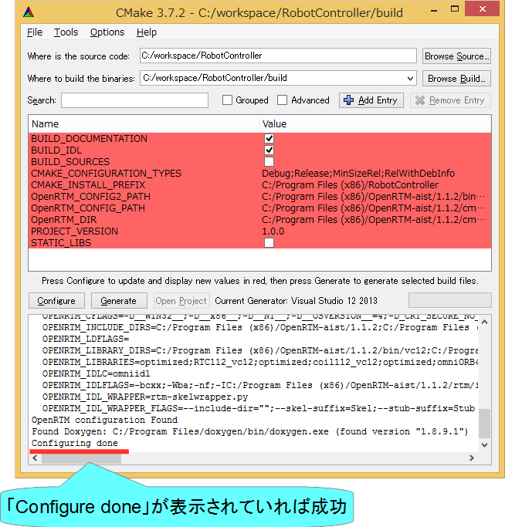
ビルドに必要なファイルの生成
44
Notes:
44
At first, I’d like to mention about RT.
What is RT?
RT means Robot Technology.
This is not only standalone robots like this, but also robotic elements, sensors, actuators and so on.
We have studied on RT-Middleware.
RT-Middleware is software platform to integrate these RT-elements.

Slide 45
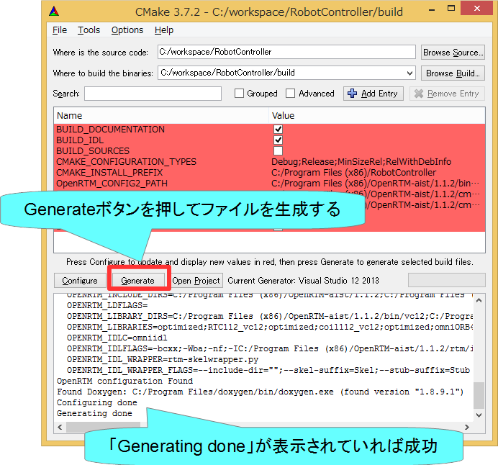
ビルドに必要なファイルの生成
45
Notes:
45
At first, I’d like to mention about RT.
What is RT?
RT means Robot Technology.
This is not only standalone robots like this, but also robotic elements, sensors, actuators and so on.
We have studied on RT-Middleware.
RT-Middleware is software platform to integrate these RT-elements.

Slide 46
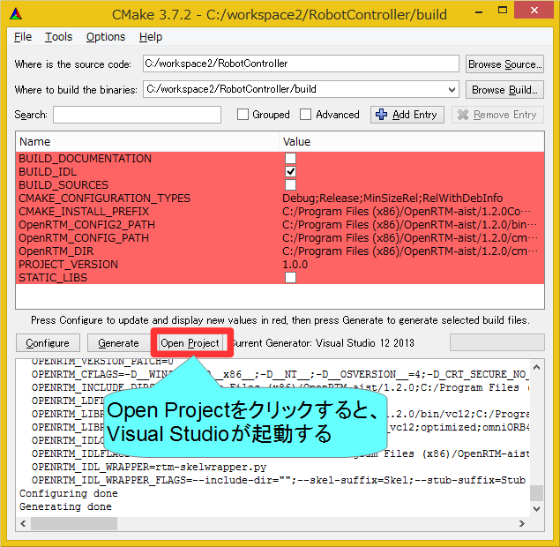
ソースコードの編集
46
Notes:
46
At first, I’d like to mention about RT.
What is RT?
RT means Robot Technology.
This is not only standalone robots like this, but also robotic elements, sensors, actuators and so on.
We have studied on RT-Middleware.
RT-Middleware is software platform to integrate these RT-elements.

Slide 47
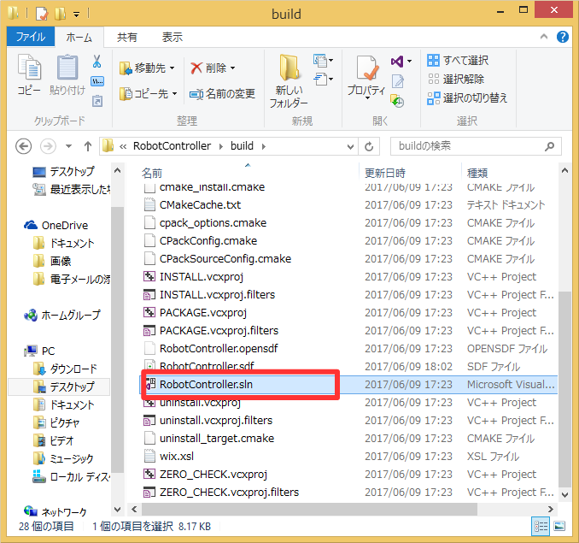
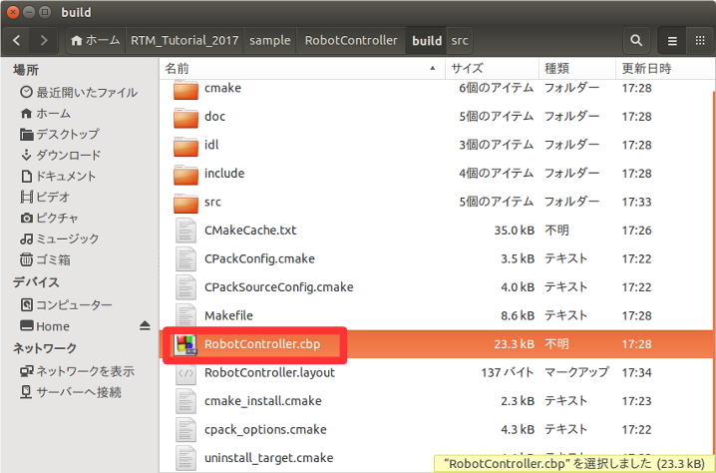
ソースコードの編集
CMake-guiのバージョンが古い場合は「Open Project」ボタンがないため、ファイルをダブルクリックして開く
Windows
buildフォルダの「RobotController.sln」をダブルクリックして開く
Ubuntu
buildフォルダの「RobotController.cbp」をダブルクリックして開く
47
Notes:
47
At first, I’d like to mention about RT.
What is RT?
RT means Robot Technology.
This is not only standalone robots like this, but also robotic elements, sensors, actuators and so on.
We have studied on RT-Middleware.
RT-Middleware is software platform to integrate these RT-elements.

Slide 48


ソースコードの編集
Windows
Visual Studioが起動
Ubuntu
Code::Blocksが起動
48
Notes:
48
At first, I’d like to mention about RT.
What is RT?
RT means Robot Technology.
This is not only standalone robots like this, but also robotic elements, sensors, actuators and so on.
We have studied on RT-Middleware.
RT-Middleware is software platform to integrate these RT-elements.

Slide 49


ソースコードの編集
RobotController.hの編集
Visual Studio
Code::Blocks
49
Notes:
49
At first, I’d like to mention about RT.
What is RT?
RT means Robot Technology.
This is not only standalone robots like this, but also robotic elements, sensors, actuators and so on.
We have studied on RT-Middleware.
RT-Middleware is software platform to integrate these RT-elements.

Slide 50

ソースコードの編集
RobotController.hの編集
センサ値を一時格納する変数の宣言
int sensor_data[4];
50
Notes:
50
At first, I’d like to mention about RT.
What is RT?
RT means Robot Technology.
This is not only standalone robots like this, but also robotic elements, sensors, actuators and so on.
We have studied on RT-Middleware.
RT-Middleware is software platform to integrate these RT-elements.

Slide 51


ソースコードの編集
RobotController.cppの編集
詳細はWEBページの資料を参考にしてください
Visual Studio
Code::Blocks
51
Notes:
51
At first, I’d like to mention about RT.
What is RT?
RT means Robot Technology.
This is not only standalone robots like this, but also robotic elements, sensors, actuators and so on.
We have studied on RT-Middleware.
RT-Middleware is software platform to integrate these RT-elements.

Slide 52


ソースコードの編集
RobotController.cppの編集
52
Notes:
52
At first, I’d like to mention about RT.
What is RT?
RT means Robot Technology.
This is not only standalone robots like this, but also robotic elements, sensors, actuators and so on.
We have studied on RT-Middleware.
RT-Middleware is software platform to integrate these RT-elements.

Slide 53

ソースコードの編集
RobotController.cppの編集
53
Notes:
53
At first, I’d like to mention about RT.
What is RT?
RT means Robot Technology.
This is not only standalone robots like this, but also robotic elements, sensors, actuators and so on.
We have studied on RT-Middleware.
RT-Middleware is software platform to integrate these RT-elements.

Slide 54

ソースコードの編集
データを読み込む手順
54
Notes:
54
At first, I’d like to mention about RT.
What is RT?
RT means Robot Technology.
This is not only standalone robots like this, but also robotic elements, sensors, actuators and so on.
We have studied on RT-Middleware.
RT-Middleware is software platform to integrate these RT-elements.

Slide 55

ソースコードの編集
データを書き込む手順
55
Notes:
55
At first, I’d like to mention about RT.
What is RT?
RT means Robot Technology.
This is not only standalone robots like this, but also robotic elements, sensors, actuators and so on.
We have studied on RT-Middleware.
RT-Middleware is software platform to integrate these RT-elements.

Slide 56


ソースコードのコンパイル
Visual Studio
Code::Blocks
成功した場合、実行ファイルが生成される
Windows
build\srcフォルダのRelease(もしくはDebug)フォルダ内にRobotControllerComp.exeが生成される
Ubuntu
build/srcフォルダにRobotControllerCompが生成される
56
Notes:
56
At first, I’d like to mention about RT.
What is RT?
RT means Robot Technology.
This is not only standalone robots like this, but also robotic elements, sensors, actuators and so on.
We have studied on RT-Middleware.
RT-Middleware is software platform to integrate these RT-elements.

Slide 57
システム構築支援ツール
RT System Editorについて

Slide 58

RT System Editor
RTCをGUIで操作するためのツール
データポート、サービスポートの接続
アクティブ化、非アクティブ化、リセット、終了
コンフィギュレーションパラメータの操作
実行コンテキストの操作
実行周期変更
実行コンテキストの関連付け
複合化
マネージャからRTCを起動
作成したRTシステムの保存、復元
58
Notes:
58
At first, I’d like to mention about RT.
What is RT?
RT means Robot Technology.
This is not only standalone robots like this, but also robotic elements, sensors, actuators and so on.
We have studied on RT-Middleware.
RT-Middleware is software platform to integrate these RT-elements.

Slide 59

RT System Editorの起動
59
Notes:
59
At first, I’d like to mention about RT.
What is RT?
RT means Robot Technology.
This is not only standalone robots like this, but also robotic elements, sensors, actuators and so on.
We have studied on RT-Middleware.
RT-Middleware is software platform to integrate these RT-elements.

Slide 60

RT System Editorの画面構成
60
Notes:
60
At first, I’d like to mention about RT.
What is RT?
RT means Robot Technology.
This is not only standalone robots like this, but also robotic elements, sensors, actuators and so on.
We have studied on RT-Middleware.
RT-Middleware is software platform to integrate these RT-elements.

Slide 61

RobotControllerコンポーネントの動作確認
シミュレータコンポーネントと接続してシミュレータ上のロボットを操作するRTシステムを作成する
ネームサーバーを起動する
RaspberryPiMouseSimulatorコンポーネントを起動する
Windows
展開したZIPファイルのEXEフォルダ内「 RaspberryPiMouseSimulatorComp.exe 」をダブルクリック
Ubuntu
インストールしていない場合
$ wget https://raw.githubusercontent.com/OpenRTM/RTM_Tutorial_ROBOMECH2019/master/script/install_raspimouse_simulator.sh
$ sh install_raspimouse_simulator.sh
RasPiMouseSimulatorRTCに移動して以下のコマンドを実行
$ build/src/RaspberryPiMouseSimulatorComp
RobotControllerコンポーネント起動
RaspberryPiMouseSimulatorコンポーネントとRobotControllerコンポーネントを接続して「All Activate」を行う
61
Notes:
61
At first, I’d like to mention about RT.
What is RT?
RT means Robot Technology.
This is not only standalone robots like this, but also robotic elements, sensors, actuators and so on.
We have studied on RT-Middleware.
RT-Middleware is software platform to integrate these RT-elements.

Slide 62



ネームサーバーの起動
オブジェクトを名前で管理するサービス
RTCを一意の名前で登録する
RT System Editor等のツールはネームサーバーから名前でRTCの参照を取得する
起動する手順
62
Notes:
62
At first, I’d like to mention about RT.
What is RT?
RT means Robot Technology.
This is not only standalone robots like this, but also robotic elements, sensors, actuators and so on.
We have studied on RT-Middleware.
RT-Middleware is software platform to integrate these RT-elements.

Slide 63



ネームサーバーの起動
OpenRTM-aist 1.1.2以前の手順
Windows 7
「スタート」→「すべてのプログラム」→「OpenRTM-aist 1.2.0」→「Tools」→「Start Naming Service」
Windows 8.1
「スタート」→「アプリビュー(右下矢印)」→「OpenRTM-aist 1.2.0」→「Start Naming Service」
Windows 10
左下の「ここに入力して検索」にStart Naming Serviceと入力して起動
Ubuntu
$ rtm-naming
63
Notes:
63
At first, I’d like to mention about RT.
What is RT?
RT means Robot Technology.
This is not only standalone robots like this, but also robotic elements, sensors, actuators and so on.
We have studied on RT-Middleware.
RT-Middleware is software platform to integrate these RT-elements.

Slide 64
RobotControllerコンポーネントの動作確認
シミュレータコンポーネントと接続してシミュレータ上のロボットを操作するRTシステムを作成する
ネームサーバーを起動する
RaspberryPiMouseSimulatorコンポーネントを起動する
Windows
展開したZIPファイルのEXEフォルダ内「 RaspberryPiMouseSimulatorComp.exe 」をダブルクリック
Ubuntu
インストールしていない場合
$ wget https://raw.githubusercontent.com/OpenRTM/RTM_Tutorial_ROBOMECH2019/master/script/install_raspimouse_simulator.sh
$ sh install_raspimouse_simulator.sh
RasPiMouseSimulatorRTCに移動して以下のコマンドを実行
build/src/RaspberryPiMouseSimulatorComp
RobotControllerコンポーネント起動
Windows
build\srcフォルダのRelease(もしくはDebug)フォルダ内にRobotControllerComp.exeが生成されているためこれを起動する
Ubuntu
build/srcフォルダにRobotControllerCompが生成されているためこれを起動する
RobotControllerコンポーネント、RasPiMouseSimulatorコンポーネントを接続して「All Activate」を行う
64
Notes:
64
At first, I’d like to mention about RT.
What is RT?
RT means Robot Technology.
This is not only standalone robots like this, but also robotic elements, sensors, actuators and so on.
We have studied on RT-Middleware.
RT-Middleware is software platform to integrate these RT-elements.

Slide 65


データポートの接続
Notes:
65
At first, I’d like to mention about RT.
What is RT?
RT means Robot Technology.
This is not only standalone robots like this, but also robotic elements, sensors, actuators and so on.
We have studied on RT-Middleware.
RT-Middleware is software platform to integrate these RT-elements.

Slide 66



データポートの接続
Notes:
66
At first, I’d like to mention about RT.
What is RT?
RT means Robot Technology.
This is not only standalone robots like this, but also robotic elements, sensors, actuators and so on.
We have studied on RT-Middleware.
RT-Middleware is software platform to integrate these RT-elements.

Slide 67

データポートの接続
Notes:
67
At first, I’d like to mention about RT.
What is RT?
RT means Robot Technology.
This is not only standalone robots like this, but also robotic elements, sensors, actuators and so on.
We have studied on RT-Middleware.
RT-Middleware is software platform to integrate these RT-elements.

Slide 68


アクティブ化
Notes:
68
At first, I’d like to mention about RT.
What is RT?
RT means Robot Technology.
This is not only standalone robots like this, but also robotic elements, sensors, actuators and so on.
We have studied on RT-Middleware.
RT-Middleware is software platform to integrate these RT-elements.

Slide 69


コンフィギュレーションパラメータの操作
コンフィギュレーションパラメータをRT System Editorから操作する
以下の動作ができるか確認
シミュレータ上のロボットがスライダーで操作できるか？
ロボットが障害物に近づくと停止するか？
69
Notes:
69
At first, I’d like to mention about RT.
What is RT?
RT means Robot Technology.
This is not only standalone robots like this, but also robotic elements, sensors, actuators and so on.
We have studied on RT-Middleware.
RT-Middleware is software platform to integrate these RT-elements.

Slide 70



動作確認
距離センサに壁が近づくと停止する場合
壁の手前に停止する
壁まで前進する
距離センサに壁が近づいても停止しない場合
壁に接触後も前進を続ける
70
Notes:
70
At first, I’d like to mention about RT.
What is RT?
RT means Robot Technology.
This is not only standalone robots like this, but also robotic elements, sensors, actuators and so on.
We have studied on RT-Middleware.
RT-Middleware is software platform to integrate these RT-elements.

Slide 71

RTコンポーネントの状態遷移
RTCには以下の状態が存在する
Created
生成状態
実行コンテキストを生成し、start()が呼ばれて実行コンテキストのスレッドが実行中(Runnning)状態になる
自動的にInactive状態に遷移する
Inactive
非活性状態
activate_componentメソッドを呼び出すと活性状態に遷移する
RT System Editor上での表示は青
Active
活性状態
onExecuteコールバックが実行コンテキストにより実行される
リターンコードがRTC_OK以外の場合はエラー状態に遷移する
RT System Editor上での表示は緑
Error
エラー状態
onErrorコールバックが実行コンテキストにより実行される
reset_componentメソッドを呼び出すと非活性状態に遷移する
RT System Editor上での表示は赤
終了状態
Notes:
71
At first, I’d like to mention about RT.
What is RT?
RT means Robot Technology.
This is not only standalone robots like this, but also robotic elements, sensors, actuators and so on.
We have studied on RT-Middleware.
RT-Middleware is software platform to integrate these RT-elements.

Slide 72


RTコンポーネントの状態遷移(生成直後)
Notes:
72
At first, I’d like to mention about RT.
What is RT?
RT means Robot Technology.
This is not only standalone robots like this, but also robotic elements, sensors, actuators and so on.
We have studied on RT-Middleware.
RT-Middleware is software platform to integrate these RT-elements.

Slide 73


RTコンポーネントの状態遷移(アクティブ化)
Notes:
73
At first, I’d like to mention about RT.
What is RT?
RT means Robot Technology.
This is not only standalone robots like this, but also robotic elements, sensors, actuators and so on.
We have studied on RT-Middleware.
RT-Middleware is software platform to integrate these RT-elements.

Slide 74


システムの保存
Notes:
74
At first, I’d like to mention about RT.
What is RT?
RT means Robot Technology.
This is not only standalone robots like this, but also robotic elements, sensors, actuators and so on.
We have studied on RT-Middleware.
RT-Middleware is software platform to integrate these RT-elements.

Slide 75




システムの復元
以下の内容を復元
ポート間の接続
コンフィギュレーション
「Open and Create Restore」を選択した場合はマネージャからコンポーネント起動
Notes:
75
At first, I’d like to mention about RT.
What is RT?
RT means Robot Technology.
This is not only standalone robots like this, but also robotic elements, sensors, actuators and so on.
We have studied on RT-Middleware.
RT-Middleware is software platform to integrate these RT-elements.

Slide 76


非アクティブ化、終了
非アクティブ化
終了
Notes:
76
At first, I’d like to mention about RT.
What is RT?
RT means Robot Technology.
This is not only standalone robots like this, but also robotic elements, sensors, actuators and so on.
We have studied on RT-Middleware.
RT-Middleware is software platform to integrate these RT-elements.

Slide 77


RTコンポーネントの状態遷移(非アクティブ化)
Notes:
77
At first, I’d like to mention about RT.
What is RT?
RT means Robot Technology.
This is not only standalone robots like this, but also robotic elements, sensors, actuators and so on.
We have studied on RT-Middleware.
RT-Middleware is software platform to integrate these RT-elements.

Slide 78

Raspberry Piマウス実機との接続
Raspberry PiとノートPCを無線LANで接続
Raspberry Piが無線LANアクセスポイントになる
注意事項
ノートPCに複数のネットワークインターフェースが存在する場合にRTCの通信ができなくなる可能性があります。
問題が発生した場合は個別に対応します。
Raspberry Piアクセスポイント接続後はインターネットに接続できなくなります。
Raspberry Piアクセスポイント接続後に、起動済みのOpenRTP、ネームサーバー、RTCは再起動してください。
Raspberry Piはシャットダウンしてから電源スイッチをオフにするようにしてください
モーター電源スイッチはこまめに切るようにしてください
Notes:
78
At first, I’d like to mention about RT.
What is RT?
RT means Robot Technology.
This is not only standalone robots like this, but also robotic elements, sensors, actuators and so on.
We have studied on RT-Middleware.
RT-Middleware is software platform to integrate these RT-elements.

Slide 79



Rapberry Piマウスの電源について
Raspberry Piマウスを以下のどちらかと接続する
リチウムポリマーバッテリー
充電が必要(配布したバッテリーは充電済み)
VH3ピンでRaspberry Piマウスと接続する
電源ケーブル
Notes:
79
At first, I’d like to mention about RT.
What is RT?
RT means Robot Technology.
This is not only standalone robots like this, but also robotic elements, sensors, actuators and so on.
We have studied on RT-Middleware.
RT-Middleware is software platform to integrate these RT-elements.

Slide 80



電源ケーブルの接続
充電が切れることがあるのでこちら推奨
3本のケーブルを接続する
Raspberry Piマウスに接続する。
コンセントに接続
必要に応じて3P→2P変換アダプターを使用する
Notes:
80
At first, I’d like to mention about RT.
What is RT?
RT means Robot Technology.
This is not only standalone robots like this, but also robotic elements, sensors, actuators and so on.
We have studied on RT-Middleware.
RT-Middleware is software platform to integrate these RT-elements.

Slide 81


Raspberry Piの起動
Raspberry Piの電源投入
内側のスイッチをオンにする
電源を切る場合
3つ並んだスイッチの中央のボタンを1秒以上押す
10秒ほどでシャットダウンするため、その後に電源スイッチをオフにする
Notes:
81
At first, I’d like to mention about RT.
What is RT?
RT means Robot Technology.
This is not only standalone robots like this, but also robotic elements, sensors, actuators and so on.
We have studied on RT-Middleware.
RT-Middleware is software platform to integrate these RT-elements.

Slide 82


Raspberry Piとの接続
無線LANアクセスポイントとの接続
SSID、パスワードはRaspberry Piマウス上のシールに記載
接続手順(Windows)
画面右下のネットワークアイコンをクリック
raspberrypi_xxに接続後、パスワードを入力
Notes:
82
At first, I’d like to mention about RT.
What is RT?
RT means Robot Technology.
This is not only standalone robots like this, but also robotic elements, sensors, actuators and so on.
We have studied on RT-Middleware.
RT-Middleware is software platform to integrate these RT-elements.

Slide 83


RaspberryPi Mouse LiDAR付きを選択した場合
RaspberryPi Mouse LiDAR付きを選択した場合、ネームサーバー、RTCが自動起動しないため、WEBブラウザからの操作で起動する必要がある。
Chrome、Firefox、Edge等で192.168.11.1にアクセスする。
Notes:
83
At first, I’d like to mention about RT.
What is RT?
RT means Robot Technology.
This is not only standalone robots like this, but also robotic elements, sensors, actuators and so on.
We have studied on RT-Middleware.
RT-Middleware is software platform to integrate these RT-elements.

Slide 84


RaspberryPi Mouse LiDAR付きを選択した場合
ネームサーバーを起動する
Start NameServerボタンを押す
RaspberryPiMouseRTCを起動する
RaspberryPiMouseRTCのStartを押す
Notes:
84
At first, I’d like to mention about RT.
What is RT?
RT means Robot Technology.
This is not only standalone robots like this, but also robotic elements, sensors, actuators and so on.
We have studied on RT-Middleware.
RT-Middleware is software platform to integrate these RT-elements.

Slide 85

RaspberryPi Mouse LiDAR付きを選択した場合
RaspberryPiMouseRTCを起動する
元の画面に戻るには「Back to the top page.」をクリックする
これ以降の作業はLiDAR有り無しで共通
Notes:
85
At first, I’d like to mention about RT.
What is RT?
RT means Robot Technology.
This is not only standalone robots like this, but also robotic elements, sensors, actuators and so on.
We have studied on RT-Middleware.
RT-Middleware is software platform to integrate these RT-elements.

Slide 86


OpenRTP再起動
OpenRTPを終了する
OpenRTPを再起動する
デスクトップのショートカットをダブルクリックする(Windows)
「openrtp」というコマンドを入力(Ubuntu)
×をクリックして終了する
System Diagramは保存しない
Notes:
86
At first, I’d like to mention about RT.
What is RT?
RT means Robot Technology.
This is not only standalone robots like this, but also robotic elements, sensors, actuators and so on.
We have studied on RT-Middleware.
RT-Middleware is software platform to integrate these RT-elements.

Slide 87


起動済みのRTC、ネームサーバー再起動
ネームサーバーを再起動する
OpenRTM-aist 1.2の場合はネームサーバー起動ボタンで再起動
OpenRTM-aist 1.1.2の場合はネームサーバーのプロセス終了後、「Start Naming Service」を再度実行
RTC再起動
RTCをexitするか、RTC起動時に表示したウインドウの×ボタンを押して終了する
実行ファイル(RobotControllerComp.exe)を再度実行
Notes:
87
At first, I’d like to mention about RT.
What is RT?
RT means Robot Technology.
This is not only standalone robots like this, but also robotic elements, sensors, actuators and so on.
We have studied on RT-Middleware.
RT-Middleware is software platform to integrate these RT-elements.

Slide 88



ネームサーバーとの接続
Notes:
88
At first, I’d like to mention about RT.
What is RT?
RT means Robot Technology.
This is not only standalone robots like this, but also robotic elements, sensors, actuators and so on.
We have studied on RT-Middleware.
RT-Middleware is software platform to integrate these RT-elements.

Slide 89

System Diagramの表示
Notes:
89
At first, I’d like to mention about RT.
What is RT?
RT means Robot Technology.
This is not only standalone robots like this, but also robotic elements, sensors, actuators and so on.
We have studied on RT-Middleware.
RT-Middleware is software platform to integrate these RT-elements.

Slide 90

ポートの接続
RobotController0とRapberryPiMouseRTC0を接続する
Notes:
90
At first, I’d like to mention about RT.
What is RT?
RT means Robot Technology.
This is not only standalone robots like this, but also robotic elements, sensors, actuators and so on.
We have studied on RT-Middleware.
RT-Middleware is software platform to integrate these RT-elements.

Slide 91

動作確認
モーターの電源投入
外側のスイッチをONにする
RTCをアクティブ化して動作確認
Notes:
91
At first, I’d like to mention about RT.
What is RT?
RT means Robot Technology.
This is not only standalone robots like this, but also robotic elements, sensors, actuators and so on.
We have studied on RT-Middleware.
RT-Middleware is software platform to integrate these RT-elements.

Slide 92




リセット
RTCがエラー状態に遷移した場合にエディタ上には赤く表示される。
以下の操作で非アクティブ状態に戻す
Notes:
92
At first, I’d like to mention about RT.
What is RT?
RT means Robot Technology.
This is not only standalone robots like this, but also robotic elements, sensors, actuators and so on.
We have studied on RT-Middleware.
RT-Middleware is software platform to integrate these RT-elements.

Slide 93


RTコンポーネントの状態遷移(エラー)
Notes:
93
At first, I’d like to mention about RT.
What is RT?
RT means Robot Technology.
This is not only standalone robots like this, but also robotic elements, sensors, actuators and so on.
We have studied on RT-Middleware.
RT-Middleware is software platform to integrate these RT-elements.

Slide 94


RTコンポーネントの状態遷移(リセット)
Notes:
94
At first, I’d like to mention about RT.
What is RT?
RT means Robot Technology.
This is not only standalone robots like this, but also robotic elements, sensors, actuators and so on.
We have studied on RT-Middleware.
RT-Middleware is software platform to integrate these RT-elements.

Slide 95
RTC Builder
補足

Slide 96

起動済みのRTCの終了
RaspberryPiMouseRTC、RobotControllerコンポーネントが起動している場合は終了してください。
RaspberryPiMouseRTCはWEBブラウザの操作でStopボタンを押す

Slide 97


サービスポートの設定
サービスポートの追加、インターフェースの追加、設定を行う
Notes:
97
At first, I’d like to mention about RT.
What is RT?
RT means Robot Technology.
This is not only standalone robots like this, but also robotic elements, sensors, actuators and so on.
We have studied on RT-Middleware.
RT-Middleware is software platform to integrate these RT-elements.

Slide 98


サービスポートの設定
インターフェースを追加する
Notes:
98
At first, I’d like to mention about RT.
What is RT?
RT means Robot Technology.
This is not only standalone robots like this, but also robotic elements, sensors, actuators and so on.
We have studied on RT-Middleware.
RT-Middleware is software platform to integrate these RT-elements.

Slide 99



サービスポートの設定
インターフェースの設定を行う
コード生成後、Pythonの場合はidlcompile.bat(idlcompile.sh)を起動する
Notes:
99
At first, I’d like to mention about RT.
What is RT?
RT means Robot Technology.
This is not only standalone robots like this, but also robotic elements, sensors, actuators and so on.
We have studied on RT-Middleware.
RT-Middleware is software platform to integrate these RT-elements.

Slide 100

サービスポートの設定
IDLファイルについて
プログラミング言語に非依存のインターフェース定義言語
コンシュマー側でプロバイダ側のecho、get_valueなどのオペレーションを呼び出す
Notes:
100
At first, I’d like to mention about RT.
What is RT?
RT means Robot Technology.
This is not only standalone robots like this, but also robotic elements, sensors, actuators and so on.
We have studied on RT-Middleware.
RT-Middleware is software platform to integrate these RT-elements.

Slide 101


RTC Builderに関する設定
Notes:
101
At first, I’d like to mention about RT.
What is RT?
RT means Robot Technology.
This is not only standalone robots like this, but also robotic elements, sensors, actuators and so on.
We have studied on RT-Middleware.
RT-Middleware is software platform to integrate these RT-elements.

Slide 102

RTC Builderに関する設定
Notes:
102
At first, I’d like to mention about RT.
What is RT?
RT means Robot Technology.
This is not only standalone robots like this, but also robotic elements, sensors, actuators and so on.
We have studied on RT-Middleware.
RT-Middleware is software platform to integrate these RT-elements.

Slide 103


独自のデータ型の利用
独自のデータ型でデータポートの通信を行う手順
IDLファイルを作成する
MyDataType.idlを任意のフォルダ(ここではC:\UserDefType)作成
別のIDLファイルをインクルードしている場合は同じフォルダにコピーする
Notes:
103
At first, I’d like to mention about RT.
What is RT?
RT means Robot Technology.
This is not only standalone robots like this, but also robotic elements, sensors, actuators and so on.
We have studied on RT-Middleware.
RT-Middleware is software platform to integrate these RT-elements.

Slide 104

独自のデータ型の利用
独自のデータ型でデータポートの通信を行う手順
RTC Builderの設定でIDLファイルの存在するディレクトリを追加
Notes:
104
At first, I’d like to mention about RT.
What is RT?
RT means Robot Technology.
This is not only standalone robots like this, but also robotic elements, sensors, actuators and so on.
We have studied on RT-Middleware.
RT-Middleware is software platform to integrate these RT-elements.

Slide 105

独自のデータ型の利用
独自のデータ型でデータポートの通信を行う手順
Notes:
105
At first, I’d like to mention about RT.
What is RT?
RT means Robot Technology.
This is not only standalone robots like this, but also robotic elements, sensors, actuators and so on.
We have studied on RT-Middleware.
RT-Middleware is software platform to integrate these RT-elements.

Slide 106
RT System Editor
補足

Slide 107
コネクタプロファイルの設定
項目 | 設定内容
Name | 接続の名称
DataType | ポート間で送受信するデータの型．ex)TimedOctet,TimedShortなど
InterfaceType | データを送信方法．ex)corba_cdrなど
DataFlowType | データの送信手順．ex)push, pullなど
SubscriptionType | データ送信タイミング．送信方法がPushの場合有効．New, Periodic, Flushから選択
Push Rate | データ送信周期(単位：Hz)．SubscriptionTypeがPeriodicの場合のみ有効
Push Policy | データ送信ポリシー．SubscriptionTypeがNew，Periodicの場合のみ有効． all，fifo，skip，newから選択
Skip Count | 送信データスキップ数．Push PolicyがSkipの場合のみ有効
Notes:
107
At first, I’d like to mention about RT.
What is RT?
RT means Robot Technology.
This is not only standalone robots like this, but also robotic elements, sensors, actuators and so on.
We have studied on RT-Middleware.
RT-Middleware is software platform to integrate these RT-elements.

Slide 108

コネクタプロファイルの設定
InterfaceTye
データの送信方法
1.1.2ではcorba_cdr(CORBAによる通信)のみ選択可能
1.2.0では以下の通信方法も選択可能になる予定
direct(同一プロセスで起動したRTC間でデータを直接変数に渡す)
shared_memory(共有メモリによる通信)
DataFlowType
データの送信手順
Push
OutPortがInPortにデータを送る
Pull
InPortがOutPortに問い合わせてデータを受け取る
SubscriptionType
データ送信タイミング(DataFlowTypeがPush型のみ有効)
flush(同期)
バッファを介さず即座に同期的に送信
new(非同期)
バッファ内に新規データが格納されたタイミングで送信
periodic(非同期)
一定周期で定期的にデータを送信
Push Policy(SubscriptionTypeがnew、periodicのみ有効)
データ送信ポリシー
all
バッファ内のデータを一括送信
fifo
バッファ内のデータをFIFOで１個ずつ送信
skip
バッファ内のデータを間引いて送信
new
バッファ内のデータの最新値を送信(古い値は捨てられる)
Notes:
108
At first, I’d like to mention about RT.
What is RT?
RT means Robot Technology.
This is not only standalone robots like this, but also robotic elements, sensors, actuators and so on.
We have studied on RT-Middleware.
RT-Middleware is software platform to integrate these RT-elements.

Slide 109


コネクタプロファイルの設定
DataFlowType
Push
Pull
Notes:
109
At first, I’d like to mention about RT.
What is RT?
RT means Robot Technology.
This is not only standalone robots like this, but also robotic elements, sensors, actuators and so on.
We have studied on RT-Middleware.
RT-Middleware is software platform to integrate these RT-elements.

Slide 110


コネクタプロファイルの設定
SubscriptionType
flush(同期)
new、 periodic(非同期)
Notes:
110
At first, I’d like to mention about RT.
What is RT?
RT means Robot Technology.
This is not only standalone robots like this, but also robotic elements, sensors, actuators and so on.
We have studied on RT-Middleware.
RT-Middleware is software platform to integrate these RT-elements.

Slide 111

コネクタプロファイルの設定
項目 | 設定内容
Buffer length | バッファの大きさ
Buffer full policy | データ書き込み時に，バッファフルだった場合の処理．overwrite，do_nothing，blockから選択
Buffer write timeout | データ書き込み時に，タイムアウトイベントを発生させるまでの時間(単位:秒)
Buffer empty policy | データ読み出し時に，バッファが空だった場合の処理．readback，do_nothing，blockから選択
Buffer read timeout | データ読み出し時に，タイムアウトイベントを発生させるまでの時間(単位:秒)
Notes:
111
At first, I’d like to mention about RT.
What is RT?
RT means Robot Technology.
This is not only standalone robots like this, but also robotic elements, sensors, actuators and so on.
We have studied on RT-Middleware.
RT-Middleware is software platform to integrate these RT-elements.

Slide 112

サービスポートについて
コマンドレベルのやり取りを行うための仕組み
任意のタイミングで操作を行いたい時などに使用
例えばロボットアームのサーボを停止させる、ハンドを閉じる等
コンシューマ側がプロバイダ側が提供する関数群(オペレーション、メソッド)を呼び出す
インターフェースはIDLファイルで定義する。
Notes:
112
At first, I’d like to mention about RT.
What is RT?
RT means Robot Technology.
This is not only standalone robots like this, but also robotic elements, sensors, actuators and so on.
We have studied on RT-Middleware.
RT-Middleware is software platform to integrate these RT-elements.

Slide 113


サービスポートの接続
Notes:
113
At first, I’d like to mention about RT.
What is RT?
RT means Robot Technology.
This is not only standalone robots like this, but also robotic elements, sensors, actuators and so on.
We have studied on RT-Middleware.
RT-Middleware is software platform to integrate these RT-elements.

Slide 114

コンフィギュレーションパラメータについて
パラメータを外部から操作する仕組み
コンポーネント作成後に変更が必要なパラメータを設定する
例えばデバイスが接続されているCOMポート番号の設定等
Notes:
114
At first, I’d like to mention about RT.
What is RT?
RT means Robot Technology.
This is not only standalone robots like this, but also robotic elements, sensors, actuators and so on.
We have studied on RT-Middleware.
RT-Middleware is software platform to integrate these RT-elements.

Slide 115

コンフィギュレーションパラメータの設定
Notes:
115
At first, I’d like to mention about RT.
What is RT?
RT means Robot Technology.
This is not only standalone robots like this, but also robotic elements, sensors, actuators and so on.
We have studied on RT-Middleware.
RT-Middleware is software platform to integrate these RT-elements.

Slide 116



コンフィギュレーションパラメータの設定
方法1
方法2
Notes:
116
At first, I’d like to mention about RT.
What is RT?
RT means Robot Technology.
This is not only standalone robots like this, but also robotic elements, sensors, actuators and so on.
We have studied on RT-Middleware.
RT-Middleware is software platform to integrate these RT-elements.

Slide 117

マネージャの操作
CameraViewerComp.exe、OpenCVCameraComp.exeのプロセスではマネージャが起動している
マネージャがコンポーネントを起動する
Notes:
117
At first, I’d like to mention about RT.
What is RT?
RT means Robot Technology.
This is not only standalone robots like this, but also robotic elements, sensors, actuators and so on.
We have studied on RT-Middleware.
RT-Middleware is software platform to integrate these RT-elements.

Slide 118

マネージャの操作
Notes:
118
At first, I’d like to mention about RT.
What is RT?
RT means Robot Technology.
This is not only standalone robots like this, but also robotic elements, sensors, actuators and so on.
We have studied on RT-Middleware.
RT-Middleware is software platform to integrate these RT-elements.

Slide 119

マネージャの操作
マスターマネージャの起動、RT System Editorからの操作によるRTCの生成までの手順を説明する
rtc.confの設定
「manager.is_master」を「YES」に設定して起動するマネージャをマスターに設定する
manager.is_master: YES
モジュール探索パスの設定
manager.modules.load_path: ., C:\\Program Files (x86)\\OpenRTM-aist\\1.1.2\\Components\\C++\\Examples\\vc12
作成したrtc.confを設定ファイルの指定してrtcd.exeを起動する
rtcdはコマンドプロンプトからrtcd.exeを入力するか、OpenRTM-aistをインストールしたフォルダからコピーして使用する
rtcdはマネージャの起動のみを行う
～Comp.exeは起動時に特定のコンポーネントの起動も行う
RT Syetem Editorのネームサービスビューにマネージャが表示される
Notes:
119
At first, I’d like to mention about RT.
What is RT?
RT means Robot Technology.
This is not only standalone robots like this, but also robotic elements, sensors, actuators and so on.
We have studied on RT-Middleware.
RT-Middleware is software platform to integrate these RT-elements.

Slide 120

マネージャの操作
モジュールのロード
Notes:
120
At first, I’d like to mention about RT.
What is RT?
RT means Robot Technology.
This is not only standalone robots like this, but also robotic elements, sensors, actuators and so on.
We have studied on RT-Middleware.
RT-Middleware is software platform to integrate these RT-elements.

Slide 121

マネージャの操作
モジュールのロード
Notes:
121
At first, I’d like to mention about RT.
What is RT?
RT means Robot Technology.
This is not only standalone robots like this, but also robotic elements, sensors, actuators and so on.
We have studied on RT-Middleware.
RT-Middleware is software platform to integrate these RT-elements.

Slide 122



マネージャの操作
RTCの生成
Notes:
122
At first, I’d like to mention about RT.
What is RT?
RT means Robot Technology.
This is not only standalone robots like this, but also robotic elements, sensors, actuators and so on.
We have studied on RT-Middleware.
RT-Middleware is software platform to integrate these RT-elements.

Slide 123

実行コンテキストの操作
Notes:
123
At first, I’d like to mention about RT.
What is RT?
RT means Robot Technology.
This is not only standalone robots like this, but also robotic elements, sensors, actuators and so on.
We have studied on RT-Middleware.
RT-Middleware is software platform to integrate these RT-elements.

Slide 124

実行コンテキストの操作
実行周期の設定
Notes:
124
At first, I’d like to mention about RT.
What is RT?
RT means Robot Technology.
This is not only standalone robots like this, but also robotic elements, sensors, actuators and so on.
We have studied on RT-Middleware.
RT-Middleware is software platform to integrate these RT-elements.

Slide 125






実行コンテキストの操作
実行コンテキストの関連付け
RTC起動時に生成した実行コンテキスト以外の実行コンテキストと関連付け
関連付けた実行コンテキストでRTCを駆動させる
他のRTCとの実行を同期させる
Notes:
125
At first, I’d like to mention about RT.
What is RT?
RT means Robot Technology.
This is not only standalone robots like this, but also robotic elements, sensors, actuators and so on.
We have studied on RT-Middleware.
RT-Middleware is software platform to integrate these RT-elements.

Slide 126



実行コンテキストの操作
実行コンテキストの関連付け
Notes:
126
At first, I’d like to mention about RT.
What is RT?
RT means Robot Technology.
This is not only standalone robots like this, but also robotic elements, sensors, actuators and so on.
We have studied on RT-Middleware.
RT-Middleware is software platform to integrate these RT-elements.

Slide 127


複合コンポーネントの操作
複合コンポーネントの生成
Notes:
127
At first, I’d like to mention about RT.
What is RT?
RT means Robot Technology.
This is not only standalone robots like this, but also robotic elements, sensors, actuators and so on.
We have studied on RT-Middleware.
RT-Middleware is software platform to integrate these RT-elements.

Slide 128


複合コンポーネントの操作
複合コンポーネントの生成
Type
以下の3種類から選択可能
PeriodicECShared
実行コンテキストの共有
PeriodicStateShared
実行コンテキスト、状態の共有
Grouping
グループ化のみ
Notes:
128
At first, I’d like to mention about RT.
What is RT?
RT means Robot Technology.
This is not only standalone robots like this, but also robotic elements, sensors, actuators and so on.
We have studied on RT-Middleware.
RT-Middleware is software platform to integrate these RT-elements.

Slide 129

複合コンポーネントの操作
Notes:
129
At first, I’d like to mention about RT.
What is RT?
RT means Robot Technology.
This is not only standalone robots like this, but also robotic elements, sensors, actuators and so on.
We have studied on RT-Middleware.
RT-Middleware is software platform to integrate these RT-elements.

Slide 130


複合コンポーネントの操作
Notes:
130
At first, I’d like to mention about RT.
What is RT?
RT means Robot Technology.
This is not only standalone robots like this, but also robotic elements, sensors, actuators and so on.
We have studied on RT-Middleware.
RT-Middleware is software platform to integrate these RT-elements.

Slide 131


ゾンビの削除
RTCのプロセスが異常終了する等してネームサーバーにゾンビが残った場合、以下の手順で削除する
Notes:
131
At first, I’d like to mention about RT.
What is RT?
RT means Robot Technology.
This is not only standalone robots like this, but also robotic elements, sensors, actuators and so on.
We have studied on RT-Middleware.
RT-Middleware is software platform to integrate these RT-elements.

Slide 132

RT System Editorに関する設定
Notes:
132
At first, I’d like to mention about RT.
What is RT?
RT means Robot Technology.
This is not only standalone robots like this, but also robotic elements, sensors, actuators and so on.
We have studied on RT-Middleware.
RT-Middleware is software platform to integrate these RT-elements.

Slide 133



進捗の確認
Zoomの挙手ボタンで確認する
参加者の画面を表示する
問題があれば手を挙げる
解決したら手を降ろす
133
Notes:
133
At first, I’d like to mention about RT.
What is RT?
RT means Robot Technology.
This is not only standalone robots like this, but also robotic elements, sensors, actuators and so on.
We have studied on RT-Middleware.
RT-Middleware is software platform to integrate these RT-elements.

